Slide 1

Cloud Computing for Data Analysis Final Project University of North Carolina at Charlotte
Ramit Aditya
Anirudh Cheruvu
Mounisha Bolla
Amirthavarshini Dhanavel
Delphine Antony Muthu
Predicting students dropout and academic success
Notes:
Students: Use this template to effectively present and communicate your group project to a broader audience. Your students can also use this presentation as a portfolio of their work to demonstrate their cloud skills.
The presentation structure is listed below. The total time may vary depending on the activities your team wants to include. For example, your team may to provide a high-level walkthrough of your work solutions versus a deep-dive into why or how your team chose certain services and the steps of building the architectures.
Suggested timing for a 10-minute presentation:
Introduction – 1 minute
Business scenario overview – 1 minute
Solution overview – 2 minutes
Architecture diagram of the solution – 2 minutes
Demo – 3 minutes
Lessons learned – 1 minute

Slide 2
Business Scenario Overview
In this project, we attempted to tackle the challenge of predicting academic dropouts in higher education by applying machine learning.
Our approach includes a comprehensive dataset sourced from UCI repository, encompassing student demographics, academic paths, and socio-economic factors.
We narrowed down the core problem to a classification task, where students are classified into one of three categories: dropout, enrolled, or graduate.
Our focus was in applying Educational Data Mining and Learning Analytics to improve educational outcomes.
There are significant opportunities in early intervention strategies and educational process enhancements.
Our potential stakeholders involve educators, students, academic institutions, and policymakers.
Notes:
Define the problem or opportunity that you are addressing. Include pictures, figures, and statistics to help the audience better conceptualize the problem or opportunity.
Specify who your users or customers are and why they care..
List any specific business requirements that you are addressing.
Note:
A good overview succinctly defines the problem and opportunity statement. For example: “Customers with media files, such as retail companies, need an easy and cost-effective way to analyze photos and videos of their inventory.”
A below standard overview is too verbose, technical, or not specific. For example: “The most common media files are .jpg and .mp4. Companies have media files of their inventory.”

Slide 3
Solution Overview
We have built a machine learning model to predict student dropout.
We explored two different approaches to build our model. They are:
❖ Neural Network model with Simple Dense Layers
❖ Logistic Regression
Use case: The project focuses on leveraging machine learning techniques to identify students who may be at risk of encountering academic challenges at an early stage in their academic journey.
Conducted extensive preprocessing to handle anomalies, outliers, and missing values. This involved a systematic approach to cleaning and organizing the data, ensuring that it was suitable for analysis.
GITHUB : https://github.com/DelphineMeera/Predict-students-dropout-and-academic-success
Notes:
Explain at a high level what you have built.
For example: “Our team built a web application for a company to host their blog.“
Talk about why you chose certain parts of the solutions and any tradeoffs that you made. Focus on how you designed the solutions and how you applied the AWS Well-Architected Framework as part of the process (AWS Well-Architected Framework: https://docs.aws.amazon.com/wellarchitected/latest/framework/welcome.html).
For example: “Our team configured load balancers and auto scaling to make the application highly available and reliable.”
Include the use cases that you are addressing. Think about who your users are and how they would want to interact with your solution to solve their problem.
For example: “Users can view, upload, edit, and delete blog posts. Administrators can approve blog posts.”
Talk about the use cases that you addressed as part of the minimum viable product (MVP) that you scoped and built.
Note:
An above-bar description is concise and includes the most important benefits. For example: “The solution allows customers to quickly upload, store, and search large catalogs of images and videos in Amazon S3.”
A below-bar description is too detailed or not specific. For example: “Our solution analyzes media files.”

Slide 4
Data Pre-processing:
Ensured data cleanliness, accurate labeling, and representation of real-world scenarios.
Encoded categorical variables.
Applied feature extraction over all the features by selecting a few out of the bunch given to us from the dataset.
Data Partitioning:
Split the data into training, testing, and validation sets for training, validation as well as testing of the model in each phase of development.
The data was split into 80% training, and 10% testing and 10% validation sets.

Slide 5
MACHINE LEARNING FRAMEWORKS
Below are the list of tools used in this project:
➢ Amazon S3 buckets
➢ Amazon Sagemaker
➢ Amazon SageMaker Ground Truth
➢ AWS Identity and Access Management (IAM)
➢ Amazon Athena
➢ AWS CodePipeline and AWS CodeBuild
➢ AWS Documentation
➢ TensorFlow
➢ Scikit-Learn

Slide 6
Use of AWS Services
Amazon S3 (Simple Storage Service):
Use S3 to store and manage "Predict students' dropout and academic success" dataset and model training data.
Amazon Athena:
Query data stored in S3 using SQL with Amazon Athena for analysis and preprocessing.
Amazon SageMaker:
SageMaker to train the models, perform hyperparameter tuning, and deploy endpoints for
predictions of dropout or graduate or enrolled.
Amazon SageMaker Ground Truth:
For data labeling and annotation tasks, use SageMaker Ground Truth to efficiently label our
dataset for training.

Slide 7
AWS Identity and Access Management (IAM)
Use IAM to manage access to AWS services securely, creating roles and permissions for
different components of your project. Amazon CloudWatch: Set up CloudWatch for
monitoring and logging. It helps track the performance of your machine learning models and AWS resources.
AWS CodePipeline and AWS CodeBuild:
Set up CI/CD pipelines using CodePipeline and CodeBuild for automated model training and
deployment. Whenever there are updates or improvements to the machine learning models,
these pipelines automate the deployment process.
AWS Documentation:
The AWS documentation serves as a valuable resource for troubleshooting, optimizing
performance, and ensuring the project adheres to AWS best practices for machine learning
implementations in the context of addressing academic dropout and failure.

Slide 8
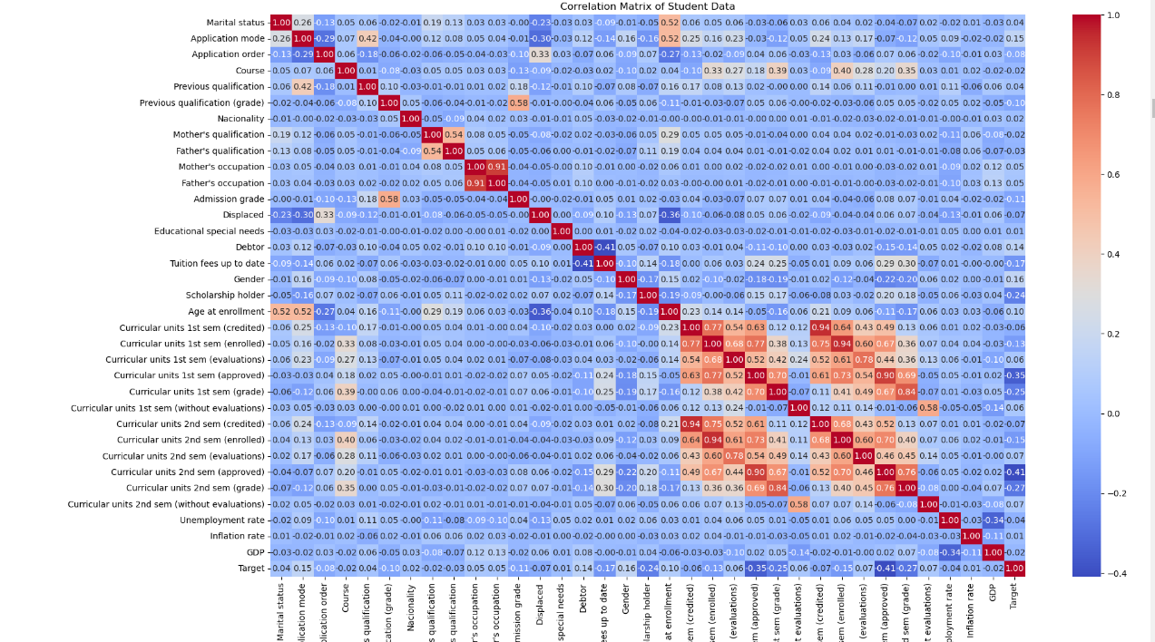
HeatMap
Data Analysis: Plotted a heatmap to understand the correlation between features

Slide 9
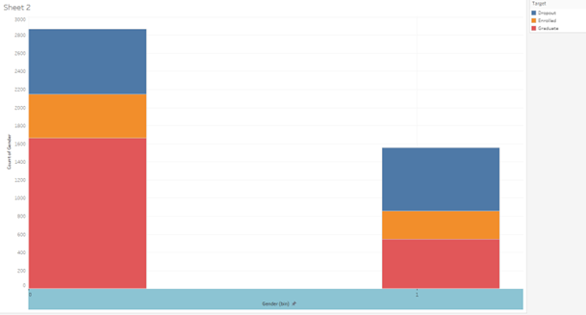
Data Visualisations
We have used “Tableau” to plot the data Visualisations.
Plotted a bar graph to show the number of graduates, dropouts as well as enrolled students with respect to each gender.

Slide 10
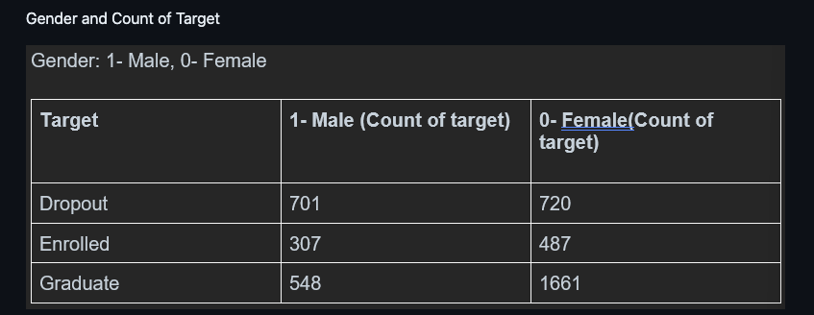
Plotted the Gender and count of Target

Slide 11
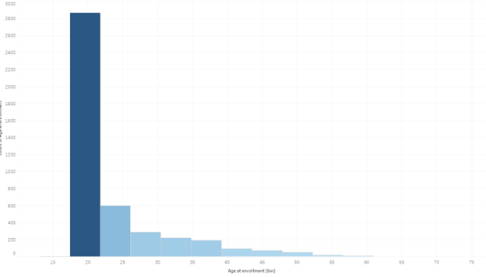
Bar graph to show the number of students enrolled at each age section

Slide 12
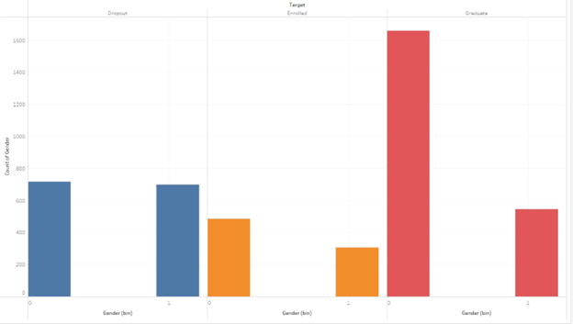
Distribution of number of students who graduated, enrolled, dropped out in each gender

Slide 13
Neural Network model with Simple Dense Layers
Training and Validation Loss:
The training loss decreases sharply and then plateaus, showing the model is learning effectively from the training data.
Training and Validation Accuracy:
The training accuracy increases consistently, indicating learning over time.
The validation accuracy also increases reaching 78.28%, but with some fluctuations, suggesting that the model may not generalize as well to new data.
On testing dataset, model achieves an accuracy of 73.81%

Slide 14
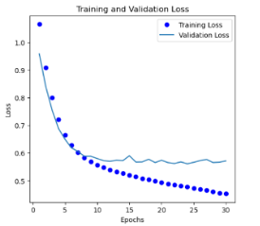
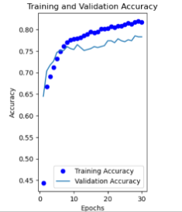
Neural Network model with Simple Dense Layers
Fig.Training and validation loss Fig.Training and validation accuracy

Slide 15
Logistic regression model
The logistic regression model initially performed for an accuracy 88.1% which needed hyperparameter tuning to increase the accuracy.
Here, the confusion matrix has been visualized in the pictures below.
Along with it, precision, recall f1-scores of the base model have been put as well.
The number of observations belonging to the classes True positive,True negative, False positive as well as False negative have been listed.

Slide 16
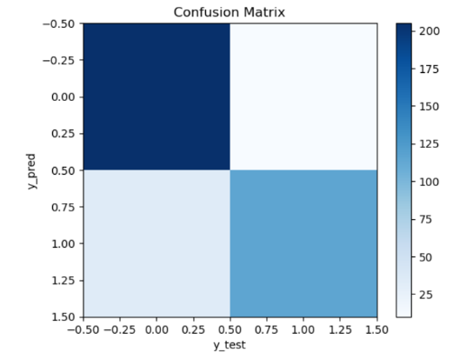
Confusion Matrix
From the confusion matrix heatmap, we can see that the majority of the observations have been correctly classified in the True positive and the True negative classes. With other two classes having significantly less observations, i.e, False positive as well as false negative classes.
True Positives (TP): 115
False Positives (FP): 18
True Negatives (TN): 285
False Negatives (FN): 33

Slide 17
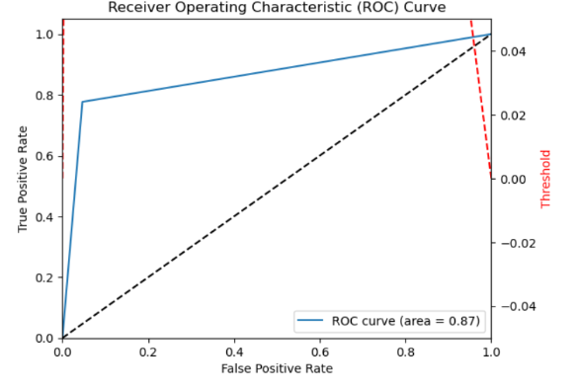
ROC-Curve
The ROC-curve has been visualized as well in the pictures below.
We have obtained an ROC- curve area of 0.87.

Slide 18
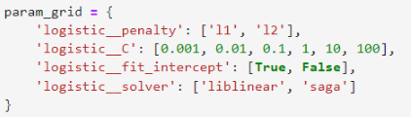
Hyperparameter Tuning
Logistic regression model:
The logistic regression model initially performed for an accuracy 88.1% which needed hyperparameter tuning to increase the accuracy.
The GridSearchCV from AWS is used for logistic regression because it performs an exhaustive search over all possible combinations of hyperparameters to find the best combination.
After performing hyperparameter tuning the accuracy increased to 91.71%.
Logistic regression is computationally less intensive compared to training neural networks, especially deep neural networks. If we have limited resources, logistic regression may be a more practical choice.

Slide 19
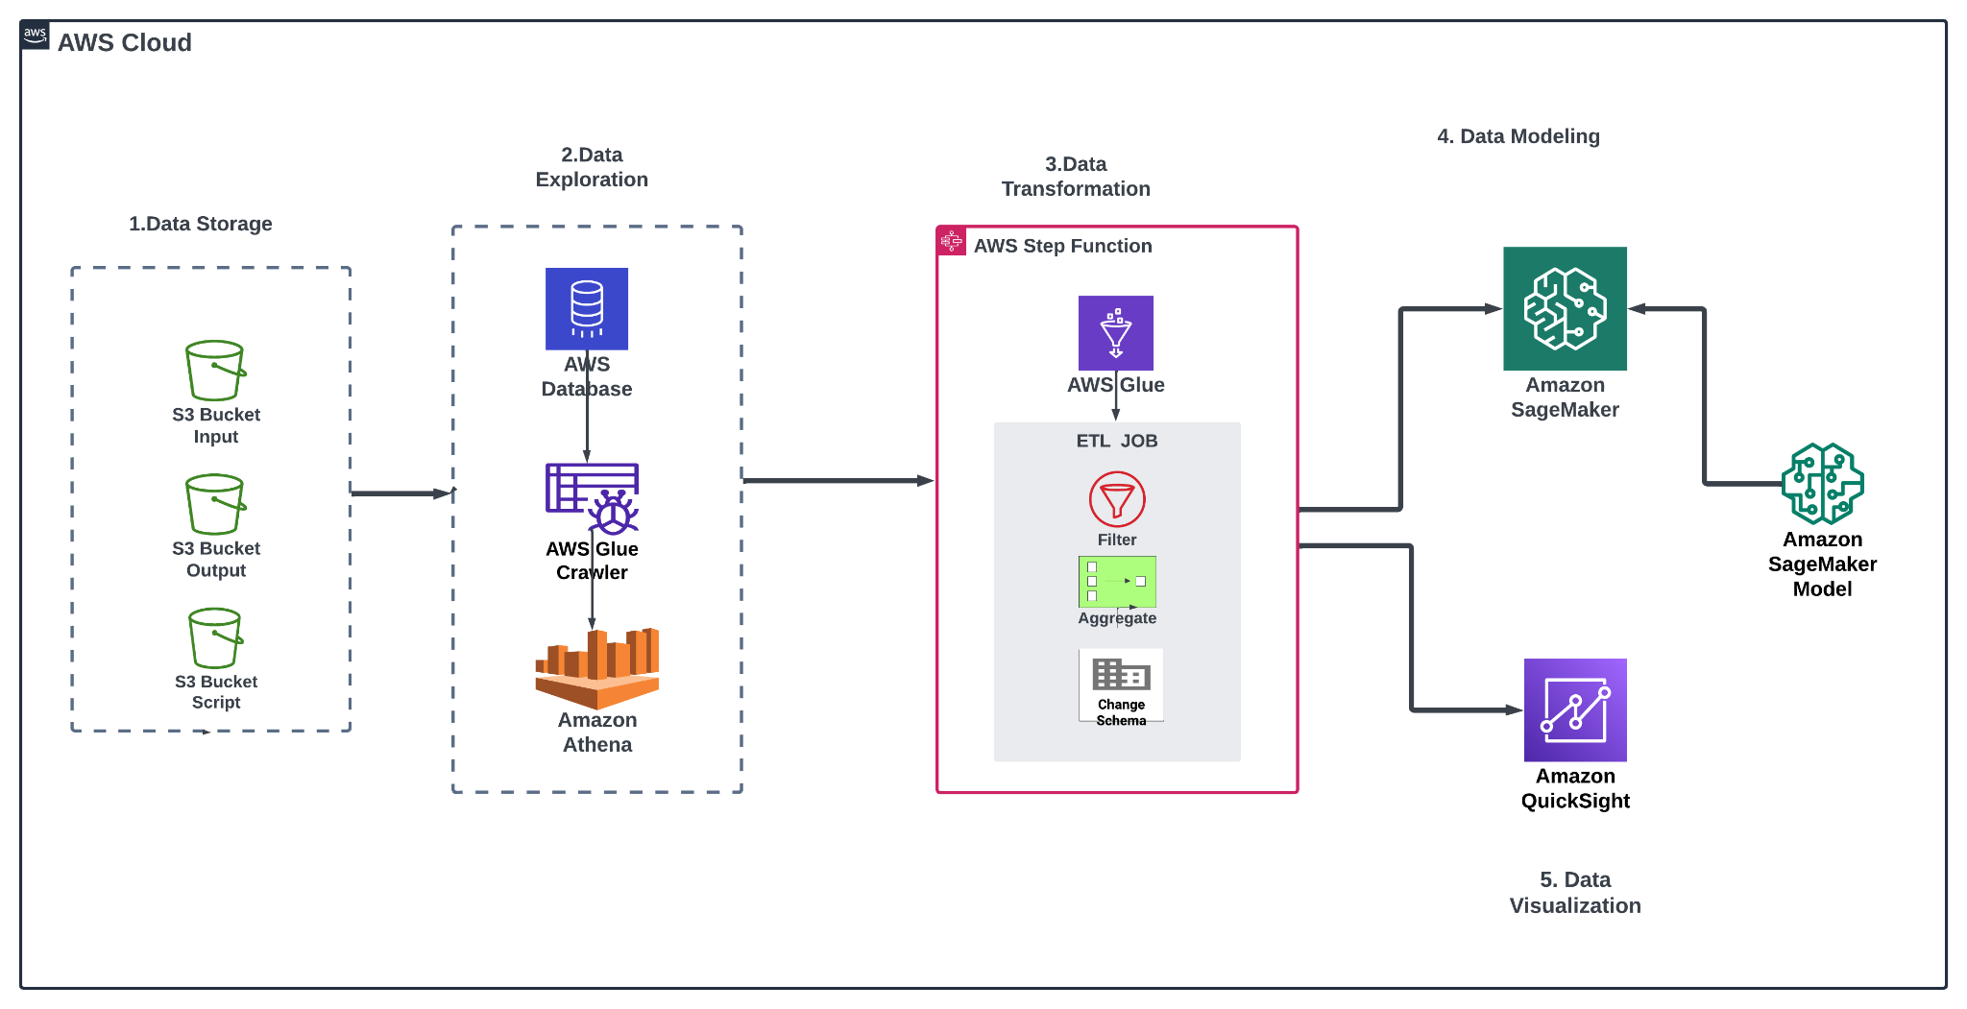
Architecture diagram of the solution
Notes:
Use the following resources to create a diagram of your application architecture:
AWS Architecture Icons at https://aws.amazon.com/architecture/icons. This page includes diagram assets as well as links to drawing and diagramming tools that you can use.
As you walk through the architecture, make sure that you relate back to the business requirements and the AWS Well-Architected Framework (https://docs.aws.amazon.com/wellarchitected/latest/framework/welcome.html).
You can also go more in depth about the design considerations and trade-offs that you made.

Slide 20
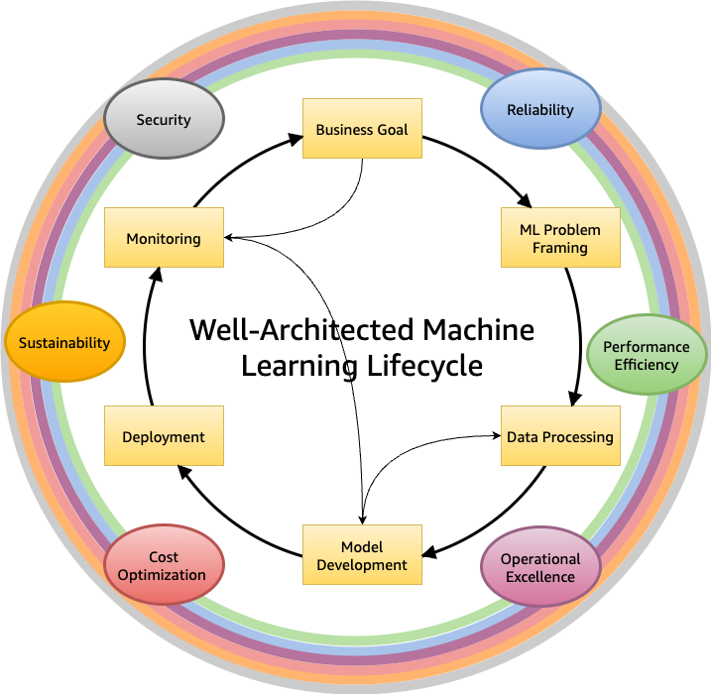
Machine Learning Lifecycle

Slide 21
Cost Optimization
AWS Services Used: Amazon S3, Athena, QuickSight, AWS Glue, and SageMaker.
Total Monthly Cost: $124.85, leading to an annual cost of $1,498.20.
Cost Breakdown: Includes storage, data processing, queries, and visualization costs.
Optimization Strategies: Reviewing instance sizes and scaling patterns in SageMaker, investigating data transfer and storage patterns in S3 and Athena, and optimizing QuickSight usage.

Slide 22
Lessons learned
• Describe any challenges that you overcame.
Overcame the challenge of complex data transformations during ETL using AWS Glue. Developed and fine-tuned Glue ETL jobs to handle various data types and perform filter, aggregation, and type conversion operations
• List resources that you found helpful.
AWS Documentation
AWS Athena
AWS Quicksight
• Describe any new skills that you used.
Developed proficiency in designing and implementing ETL jobs using AWS Glue.
Acquired new skills in using AWS SageMaker for machine learning tasks and understanding of SageMaker algorithms and optimization techniques
• Explain next steps.
Plan to explore advanced optimization techniques in AWS SageMaker to further enhance model accuracy and performance.
Explore strategies for automating ETL processes and model deployments to improve scalability.

Slide 23
Thank you

